Slide 1


Cannabis Health Plan
If cannabis users purchase $100 or more per month in cannabis, then they qualify
“First To Market Health Carrier That Covers Cannabis Benefits For Medicinal And Recreational Users”
SEPTEMBER 2025 INVESTOR DECK
Presented by: Novus Acquisition & Development Corp a Nevada corporation with its wholly owned subsidiary WCIG insurance, Inc. d/b/a Novus Cannabis MedPlan

Slide 2






Opportunities That Benefit Novus
Compassionate Care Act
Precedence set by the Supreme Court where employers are obligated not to terminate employees that use legal medicinal cannabis, paving the way for Group Sales and Employer-Sponsored Health Plans
Opioid Settlement Framework
Consortia of State Attorney Generals are settling litigation claims with health carrier distribution networks with compensatory damages, rehabilitation, and opioid diversion programs utilizing Novus’ plans
Rising Recreational Cannabis Taxation
Taxation is as high as 37% in states like California. Once federally legal, there will be an additional 25% tax on rec cannabis, hitting the consumer with a 45% to 50% tax rate or higher as opposed to a 17% state tax rate on medicinal
Direct To Consumer Drug and Cannabis Platform
Many cultivators are adopting selling direct-to-consumer and are using delivery platforms to sell their products regionally, opening up a new segment in our provider network.
2 | Private and Confidential

Slide 3






Solutions
Employer-Sponsored Health Plans
Prompting employers to change HR policies to comply with the Compassionate Care Act by utilizing the health plans offered by Novus for their employees as means to attract and retain quality employees.
Insurance As A Corralling Tool
Novus like HMOs can compliantly corral med and rec. users to specific provider network facilities and/or brands. Giving cannabis verticals exclusive traffic.
Reduced Cannabis Taxation
Recreational users are taking advantage of Novus’s employer-sponsored health plans to get the medicinal tax rate vs the rec tax which reduces point of sale transactions as high as 50% and a saving as much as $1,200 per year.
Great Diversion Option
Health Carriers and Big Pharma are partnering with Novus MedPlan to comply with stipulated law with the Opioid Settlement Framework. Additionally, entice new policyholders and up-sell existing ones.
3 | Private and Confidential

Slide 4




About Novus Cannabis MedPlan
Novus through its wholly-owned subsidiary WCIG Insurance Services, Inc., is a hybrid health insurance carrier and, the nation’s first health carrier offering cannabis in health plans for recreational and medicinal users
Novus’ provides a value proposition in three ways :
Benefit to Shareholders
Value to Patient/Members
Value to Cannabis Verticals
Novus’ intrinsic value is based on owning receivables rather than having a high overhead and owning depreciative assets.
Secures 90% of the invested funds and dispersed as a dividend its gross income from certain venues .
Both recreational and medical users receive a 45% to 50% discount on cannabis meds from our in-network of providers.
In many cases can get reimbursed with Health Reimbursement Accounts from participating in the health plan.
Novus supports cannabis verticals by driving a loyal and exclusive client base that buys 3 times the national average per visit.
Use proximity marketing techniques that drive consumers to their facilities and /or brand
4 | Private and Confidential

Slide 5







We Do Not Touch
The Plant
Tax Benefits and Reimbursements
Novus's policies offer a win-win: consumers get to deduct their premiums tax-free, and cannabis companies gain a new revenue stream through reimbursement.
Covering More Markets D2C
Novus has a proprietary e-commerce technology that offers cannabis consumers ease and home delivery ordering.
Online Pharmacy For Expansion
Novus online pharmacy now offers prescription drug plans that include cannabis for both recreational and medicinal users. We Do Not Touch The Plant
Retargeting Using Real World Contextual Data
Maintains the audience's attention with a retargeting strategy in many devices and formats. A final and more powerful strategy is location-based audiences across devices and formats for greater reach using real-world, contextually relevant data.
Consumer Engagement Is Key
Recognizable Consumer Brands
Capture customer contact and sales data
New vs returning customer purchasing behaviors
5 | Private and Confidential

Slide 6








Benefits To Providers (cannabis verticals)
Reimbursement
Reimbursement-based revenue stream for cannabis
businesses.
Free Instant Web Presence
Join and get the online shop on the Novus MedPlan web portal
Member Access
To a loyal and exclusive patient market, averaging $300 per month in purchases (3x the national average)
Free Search Engine Optimization
Novus' portal will send to all the social networking sites updated inventory and showcase the store
Free Marketing Advertising
Novus MedPlan will cover most costs in marketing and advertising, reducing the vertical’s expenses
Free Display of Inventory
Modify pricing through the Provider portal and the get free access to our affiliate and email marketing
Push Notifications Order
Patients pre-order from our portal with push notifications to the business/dispensary
Access
Access to Novus’ provider Telemedicine platform at no cost
6 | Private and Confidential

Slide 7
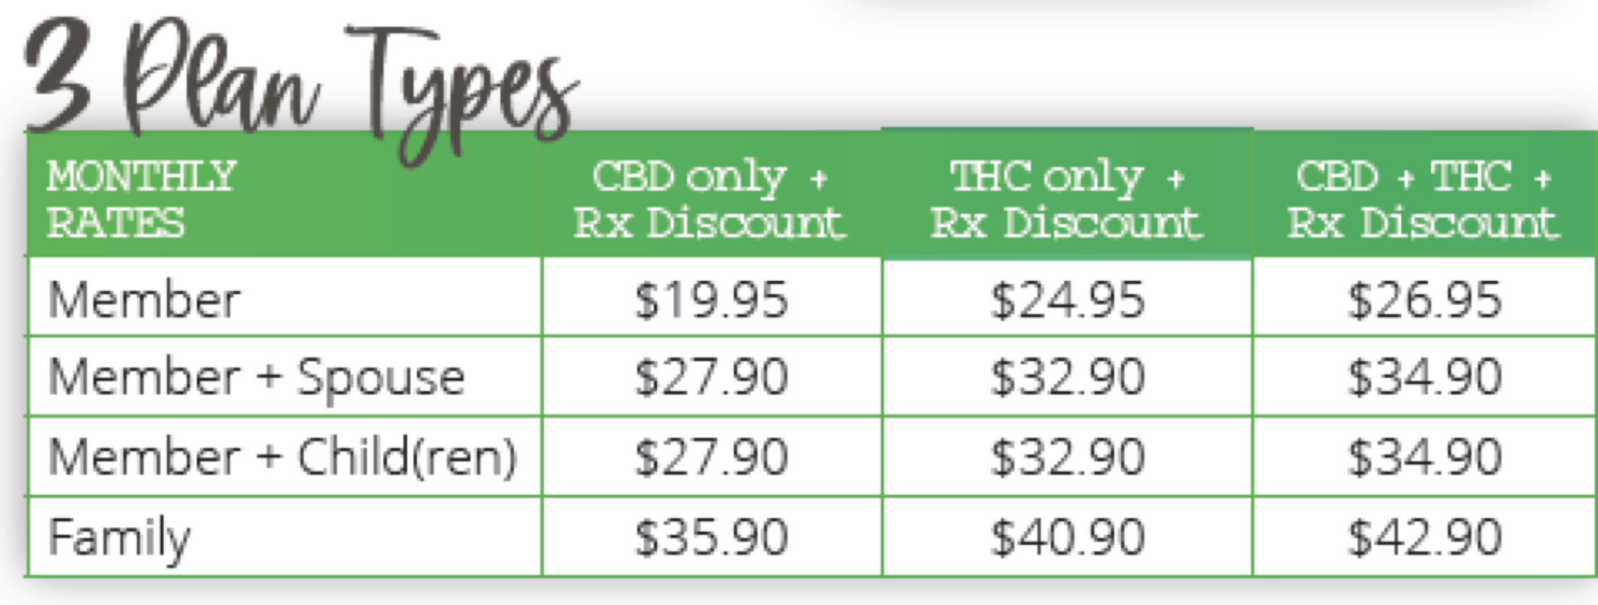
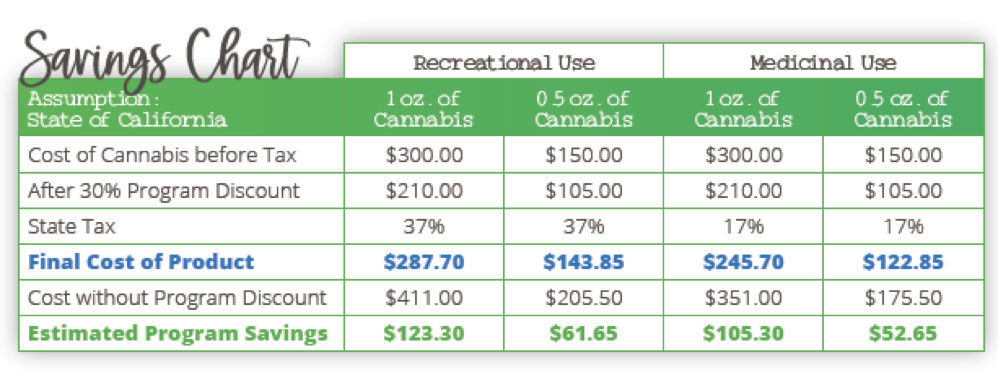
Revenue Model
Three 3 Core Plan Types:
These plans can be stand-a-lone or integrated with third-party guaranteed issue health plans, discount medical plans offered by Carriers, Third Party Administrators, Insurance Wholesalers of which we have current partnerships in place
C
THC Only Plan
THC In Legal States Only
THC/CBD Plan
Reimbursement Eligible
Perception Drug Plan
Includes Cannabis
Tax Deductible
Guaranteed Health
All Includes Cannabis
CBD Only Plan
Available Nationwide
Dental-Cannabis
Dental Includes Cannabis
7 | Private and Confidential
Private and Confidential |6

Slide 8






Value Drivers
Financial Statements
The business model is receivable business model, based on selling premiums which are fully monetized as a Net Asset Value on the Balance Sheet.
Provider Network Ahead of the Competition
Infrastructure:
Currently, we have 300+Cannabis Verticals in our Provider Network, 1,200 Selling Agents, numerous participating Health Carriers, Third Party Administrators (TPA), Pharmacy Benefits Managers (PBM), Professional Employment Organizations (PEOs), and Insurance Brokers/Group Sales
High Taxation Works In Our Favor
Corresponding state tax abatements that draw in medicinal and recreational users that further discounts cannabis at the point of sale to 45%-50%.
Cannabis Is Now Included In Consumers Household Budgeting
Another factor in the compliance of corralling consumers using Employer-Sponsored Health Plans
What Attracts Consumers To Novus
The consumer can counteract their high deductible health plans as health care costs outpace inflation 3 times
8 | Private and Confidential

Slide 9








Value Drivers
Limited Overhead and Burn Rate
As a receivable-based business, we don’t touch the plant nor carry any inventory which reduces overhead keeping it at a 3% administrative cost.
Provider Network Growth
We acquire approx. 12-15 new cannabis verticals per month that offer a preferred rate (minimum 30% discount) at the point of sale.
Assist State Law Enforcement
Combat illicit cannabis sales that will top $4.5 billion by 2025 as reported by New Frontier Data.
Rx Platform
The Rx Platform will allow us to quickly scale into underdeveloped markets.
Opioid Crisis
Hospitals, clinics and physician's offices are also limiting opioid prescriptions and turning to cannabis. Many consumers ask, “Does My Health Insurance Cover Cannabis?”
Inflation, and Possible Recession Benefits Novus
Now, med and rec users assess their cannabis cost’s just as closely as other budgetary essentials. They see the benefits of a wellness program from Novus with savings on an average of 42% at point-of-sale, this will be very practical as future taxation hits above 40 to 50 percent of cannabis purchases.
9 | Private and Confidential

Slide 10
Target Expansion & Market Size
Currently: Continue to expand U.S. market
Market Size US : 45 million users
Short Term Market (1-2 years) – US and
Canada
Market Size Canada : 16 million users
Long Term Market (3-4 years) – Europe and
Latin America
Market Size Europe and Latin America : 37 million users
Legal Medical & Adult Use
Limited THC Market
Legal Medical Use Only
10 | Private and Confidential

Slide 11



North American Legal Cannabis Market
Growth Drivers
$54 B
North American legal cannabis market size in 2021
The rising legalization and growing use of marijuana for medical purposes
CAGR 10.4%
$27 B
(2022-2028)
Increase in access to recreational cannabis through the new state and federal laws
2021
2026
Growing acceptance of alternative medicines to cure serious and common health issues
11 | Private and Confidential

Slide 12






Competitive Advantage & Analysis
Though we are concerned about the competition we are confident that our brand has a first-mover advantage in acquiring a sizable provider network. Other factors weigh in our favor are:
Major Carriers Are Cautious
Since cannabis is not legal federally, many major insurance carriers will not jeopardize their multi-billion-dollar Medicare/Medicaid contracts by doing business in this sector.
  Major Carriers Are Wealthy
  Major and mid sized carriers usually concentrate on acquiring market share as opposed to creating it.
Sizeable Reach Established
We have a head start with over 300 providers in our network covering over 20,000 zip codes in the US.
Sizeable Sales Distribution
We have a sizeable and growing sales distribution with 3,000 selling agents and brokerage firms.
Great presence in California
We cover the entire state of California which has the largest cannabis users per capita in world.
Barriers to Entry
Other competitors have tried to emulate us and failed. The task of building the infrastructure was proven to be too great for them.
Note: Sunlife covers cannabis, but these are isolated incidences which the policyholder must fight to get these benefits
12 | Private and Confidential

Slide 13



Go To Market Strategy
Social Networking
Digital Ad Dissemination with Ad Exchanges
Programmatic Marketing Proximity Targeting
  Novus achieves well over 1,000,000 impressions per month with a 0.5% engagement rate to our sales funnel, a significant increase at a fraction of the cost for third-party marketers
  Achieved a significant increase of 100% in engagement rates from a 0.5% to 0.9% with our branding initiative
  The Company is engaged with 50 notable digital ad data providers and 20 exchanges that will allow advertising that contain the word marijuana and/or cannabis
  This will be a game-changer not only for Novus but also for the medical cannabis industry.
  This technology helps our marketing efforts reach for demographic audience behavior down to the longitude and latitude of our target consumer
  This is the best utilization of quality data that can identify our target audience down to every storefront dispensary
Novus utilizes Agent Affiliation, where our 3,000 Selling Agents and Brokerage Firms have a unique auto referral link/URL to promote our plans. The agent's ID is appended to the link so they can track customer visits to our website and auto-register them as their client upon conversion.
13 | Private and Confidential

Slide 14








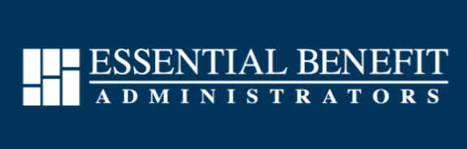
Partnerships
C
C
C
C
C
C
C
C
C
14 | Private and Confidential

Slide 15











Milestones Roadmap
2016-2017
2018-2019
2020-2024
  Acquire California Insurance Entity
  Develop Provider Network
  Begun Procuring Agents
  Hit 100 Providers
  Hit 1000 Policy sign-ups
  Signed First Health Carrier Partner
  Hit 300 Providers
  Signed Up 12 Health Carrier Partners
  Got Approved To Expand into Canada
Growth Roadmap
PHASE 1
PHASE 2
PHASE 3
Implement On-boarding of InsurTech
Begin InsurTech Marketing Campaign
Begin Investments into secure funding instruments
File with Canada the financial requirements
Begin issuing dividends from InsurTech sales
Continue Investments into secure funding instruments
Begin selling policies in Canadian
15 | Private and Confidential

Slide 16

Funding Request
Secured Guaranteed Investment Fund Accounts
Novus is looking to raise $5.0 Million USD for a runway of 6 months to expand into Canada, get placed on InsurTech Platforms and aggressively expand the provider network
The Use of Proceeds:
90% Secured Guaranteed Investment Fund Accounts. This means the invested capital will be secured as a requirement from the Canadian Department of Insurance. This is a reserve to write policies up to $25 million. These funds will never be dispersed without the consent of the investor.
10% of Proceeds: Will be for incidental and operational costs for the expansion
90%
10%
Proceeds
16 | Private and Confidential

Slide 17

Financial Projections & ROI
Download Financial Model Spreadsheet
Yr. 1
Yr.2
Yr.3
Yr. 4
Yr.5
Footnotes
1. Premise Of Investment: The investor(s) will invest a total of $5 million into the company. Of which $4,500,000 or 90% of the investment will be put in Accrual Bonds at 4% interest per annum, this goes towards the protection of the investment and the prerequisite to begin selling policies in Canada. In return on the investment, the investor will receive 4% interest of the secured investment, 15% of the gross revenue of policies sold in Canada and through InsurTech Platforms, and 15 million shares of common stock.
2. Growth Rate: See historical Quarterly and Annual Financial Statements: Click Here
3. Lives or Life: Number of people covered under a health policy.
4. Yearly Contract Per Life: Insurance policies according to GAAP are monetized on yearly basis as a Net Asset Value (NAV) vs Earnings Per Share (EPS).
5. EBITDA: Earnings Before Interest, Taxes, Depreciation, and Amortization. We have demonstrated EBITDA to be anywhere from 34% to 38%.
6. NAV: Net Asset Value is assets minus the liabilities.
7. Shares Issued: Total Shares Outstanding
8.Projected Stock Price: Aside from supply and demand the stock price is a fundamental technique used to calculate. For insurance companies, shares are calculated on a NAV, growth rate Equity in Capital, and multiples. For insurance companies, they trade at a 20x multiple
9. ROI: Return On Investment, in this case, is a projection share issued divided by EBITDA.
17 | Private and Confidential
Private and Confidential |16

Slide 18

Exit & Dividend Strategy
(Dividend 1)
(Dividend 2)
Secured Funding $5 Million
Novus plans to raise “Series A” funding with a straight dividend of 4%. Ninety percent (90%) of the principal amount of investment will go to Accrual Bonds
InsurTech Revenue
Placement of policies on InsurTech Platforms as a carrier. The investor will receive, a 15% dividend from gross proceeds from InsurTech platform sales
THIS IS SEGMENTED IN 4 WAYS
(Dividend 3)
(Dividend 4)
Canadian Revenue
In addition, once Novus is approved in Canada and begins selling policies the investor will receive a 15% dividend from gross proceeds from InsurTech platform sales.
Common Shares Of Equity
15 m shares are given in accordance with investment which have voting rights. However, Dividends 1-3 are for 5 years only after first dividend is received.
18 | Private and Confidential

Slide 19


Team
Frank Labrozzi
Andrea Lopez
CEO/Founder
EVP
Frank was a Wall Street veteran for 27 years.
He’s a results-oriented, analytical executive with
experience in a diverse range of disciplines within the finance, health, and insurance industries.
He is committed to the development of new lines of business, strategic planning, acquisitions, and building shareholder value.
Andrea has created and maintained program integrity and compliance strategic policies for numerous Fortune 500 Companies
With over two decades of corporate experience, she has a broad knowledge base encompassing executive management, professional development, and strategic communication across international healthcare industries
19 | Private and Confidential

Slide 20










IN CONCLUSION:
We look forward to hearing from you and joining us as a partner. Together we will garner success and make cannabis mainstream in health plans throughout the world.
Frank Labrozzi, CEO
Download Financial Model Spreadsheet
Book A Meeting
frank@ndev.biz
www.getnovusnow.com
Address: 2665 S. Bayshore Dr
#220 Miami FL 33176
Direct Line: 305-467-6699

